Slide 1

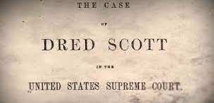
Dred Scott V. Sandford
By: Jack Cool

Slide 2
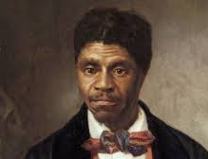
Background
Dred Scott was a slave in Missouri.
From 1833-1843 he lived in Illinois, a free state where slavery was forbidden by the Missouri Compromise
Scott claimed that since he lived in a free state for a period of time, he was a free man

Slide 3
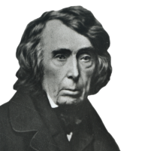
Case Facts
The case lasted from 1856-1857
Most argued that a black man could not be an American citizen and therefore could not sue in court
It was ruled that the Missouri Compromise was unconstitutional and that any law depriving a citizen of their property was unconstitutional
In March of 1857, the Supreme Court ruled 7-2 in favor of Sandford

Slide 4
Resources
https://www.oyez.org/cases/1850-1900/60us393
https://ballotpedia.org/Dred_Scott_v._Sandford

